Slide 1
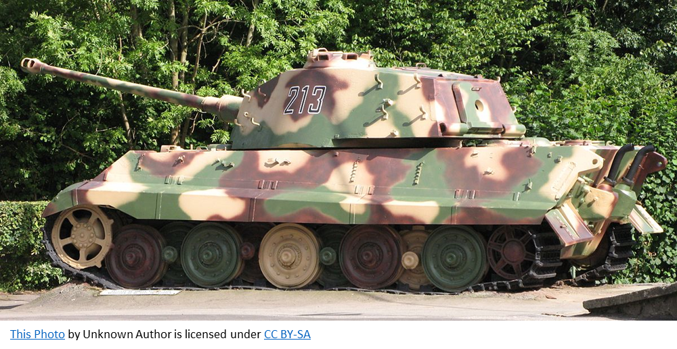
Panzerkampfwagen robot tank EA tank Project motor calculations
By: team extinguisher geeks

Slide 2

Assumptions and Constants
No air resistance
surface friction coefficient of poor concrete µ= 0.022
Radius of wheel r= 0.029m
All calculations are done with SI units
Target Vmax = 1.0 m/s
Target $t_{a}=2secs$
Max incline = 10 degrees
Acceptable time to Vmax: 1 to 5 seconds
Constant torque generated by motor
Constant position of centre of gravity
Resistance factor $R_{f}=1.1$
Number of wheels = 6
Number of drive wheels = 2
Static coefficient is 0.3 (plastic and concrete)
Number of motors = 2

Slide 3
Free body diagrams (flat ground)
Rn
Ft
Tw
Fs
Ft
mg

Slide 4
Free body diagrams (on 10 degree slope)
Rn
Ft
Ft
Tw
mg sin 10
Fs
a = 10 deg
mg
mg cos 10

Slide 5

Min Torque Calculations (Part 1)
$$F_{SF}=μ_{CF}R_{n}$$
$$F_{SF}=0.022×1.5×9.81$$
$$F_{SF}=0.324N$$
$$F_{GR}=mg\sin{a}$$
$$F_{GR}=1.5×9.81×\sin{10°}$$
$$F_{GR}=2.555N$$
$$F_{a}=ma$$
$$F_{a}=1.5×\left(1.0÷2\right)$$
$$F_{a}=0.75N$$
(Surface friction)
(Grade resistance)
(Acceleration force)

Slide 6

Min Torque Calculations (Part 2)
$$F_{T}=ΣF_{n}$$
$$F_{T}=F_{SF}+F_{GR}+F_{a}$$
$$F_{T}=0.324+2.555+0.75$$
$$F_{T}=3.629N$$
$$T_{w}=F_{T}rR_{f}$$
$$T_{w}=3.629×0.029×1.1$$
$$T_{w}=0.115Nm$$
(Sum of forces)
(Min torque needed)

Slide 7
C.G distribution diagram
Motion direction
Reference datum A
Rn1 – driving wheels: 10% from reference datum
CG: 50% from reference datum
Rn2 – idler wheels: 90% from reference datum
Height of CG: 50% from reference height
Rn3 – idler wheels: 50% from reference datum
Rn2
Rn3
Rn1
0.9
0.5
0.1
CG
Reference height h
0.5

Slide 8
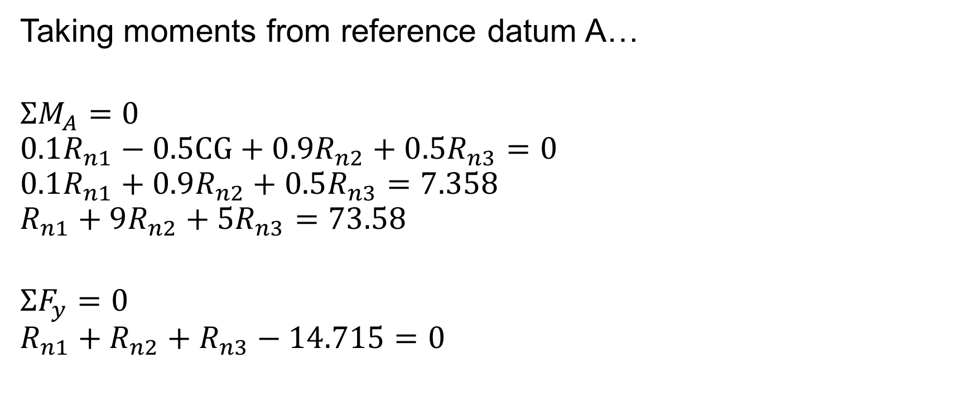
Normal force calculations
Taking moments from reference datum A…
$$ΣM_{A}=0$$
$$0.1R_{n1}−0.5CG+0.9R_{n2}+0.5R_{n3}=0$$
$$0.1R_{n1}+0.9R_{n2}+0.5R_{n3}=7.358$$
$$R_{n1}+9R_{n2}+5R_{n3}=73.58$$
$$ΣF_{y}=0$$
$$R_{n1}+R_{n2}+R_{n3}−14.715=0$$

Slide 9

Normal force calculations
Since the C.G is at 50% from datum A and reference height h and the wheels are spaced equally apart…
$$R_{n1}=R_{n2}=R_{n3}=14.715÷6=2.453N$$

Slide 10

Max Tractive Torque Calculations
$$T_{maxT}=R_{n1}rμ_{s}$$
$$T_{maxt}=2.453×0.029×0.3×2$$
$$T_{maxT}=0.0427Nm$$

Slide 11
Recommended torque and rpm
Based on my calculations, I recommend the minimum motor torque is 0.115Nm, maximum motor torque is 0.0427Nm and my recommend rpm is 350 rpm

Slide 12

Calculations (Tw vs t)
$$F_{T}=F_{s}+F_{GR}+ ma$$
$$F_{T}=3.305+1.5a$$
$$T_{T}=F_{T}r$$
$$T_{T}=0.029(3.305+1.5a)$$
$$T_{T}=0.0958+0.0435a$$
$$T_{w}=0.0958+0.0435t^{−1}$$

Slide 13

Calculations (Tw vs t)
At t=1s
$$T_{w}=0.0958 +0.0435t^{−1}$$
$$T_{w}=0.0958+0.0435{(1)}^{−1}$$
$$T_{w}=0.139Nm$$
At t=2s
$$T_{w}=0.0958+0.0435t^{−1}$$
$$T_{w}=0.0958+0.0435{(2)}^{−1}$$
$$T_{w}=0.118Nm$$

Slide 14



Tw vs t graph
$$T_{w(min)}=0.115Nm$$
$$T_{w}=0.0958+0.0435t^{−1}$$
$$T_{maxT}=0.0427Nm$$

Slide 15
Significance of the graph
The graph is to determine the suitable time to maximum speed without causing problems such as insufficient grip and insufficient wheel motor torque.

Slide 16
Conclusions based on calculations
Rated torque = 4.0 kg cm *2 = 0.784Nm
Minimum torque = 0.115Nm
Thus, I can conclude that the motor is capable of moving the tank. However, skidding issues may occur as the motor rated torque is way higher than the MTT.

Slide 17
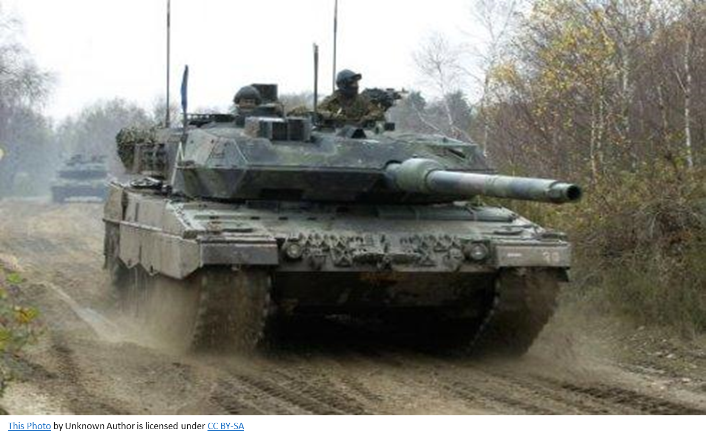
The End

Slide 18
References
https://www.aliexpress.com/item/32876428827.html?spm=a2g0o.productlist.0.0.57a63504wwE9po&algo_pvid=8d752093-fb54-45f9-957d-de7450e51106&algo_expid=8d752093-fb54-45f9-957d-de7450e51106-33&btsid=f33890fb-f45c-4f91-b59c-9c7d285caead&ws_ab_test=searchweb0_0,searchweb201602_6,searchweb201603_55

